Slide 1
Strings and varArgs

Slide 2
Exploring String class
Creating a String object
String s=“abc”.
class StringDemo {
public static void main(String args[]) {
String strOb1 = "First String";
String strOb2 = "Second String";
String strOb3 = strOb1 + " and " + strOb2;
System.out.println(strOb1);
System.out.println(strOb2);
System.out.println(strOb3);
}
}

Slide 3
// Demonstrating some String methods.
class StringDemo2 {
public static void main(String args[]) {
String strOb1 = "First String";
String strOb2 = "Second String";
String strOb3 = strOb1;
System.out.println("Length of strOb1: " +
strOb1.length() + "First String“.length() );
System.out.println("Char at index 3 in strOb1: " +
strOb1.charAt(3));

Slide 4
if(strOb1.equals(strOb2))
System.out.println("strOb1 == strOb2");
else
System.out.println("strOb1 != strOb2");
if(strOb1.equals(strOb3))
System.out.println("strOb1 == strOb3");
else
System.out.println("strOb1 != strOb3");
}
}

Slide 5
// Demonstrate String arrays.
class StringDemo3 {
public static void main(String args[]) {
String str[] = { "one", "two", "three" };
for(int i=0; i<str.length; i++)
System.out.println("str[" + i + "]: " +
str[i]);
}

Slide 6
String constructors
String(); //empty string creation
String(char ar[]);
String(char ar[],int si,int nc);//start index and number of characters
String(String ob); //copy one string to other

Slide 7
String member methods
length();
char charAt(int where);
boolean equals(Object str);
int compareTo(String str)
Return value <0 if invoking String<str
Return value>0 if invoking String>str
=0 if equal
int indexOf(int ch)
int indexOf (String sub);
String toLowerCase()
String toUppercase();

Slide 8
Sorting array of Strings
class SortString {
static String arr[] = {
"Now", "is", "the", "time", "for", "all", "good", "men",
"to", "come", "to", "the", "aid", "of", "their", "country"
};
public static void main(String args[]) {
for(int j = 0; j < arr.length; j++) {
for(int i = j + 1; i < arr.length; i++) {
if(arr[i].compareTo(arr[j]) < 0) {
String t = arr[j];
arr[j] = arr[i];
arr[i] = t; }
}
System.out.println(arr[j]); }}}

Slide 9
class Check {
public static void main(String[] args) {
String s="this is test string ";
String s1=“”; char c; int i=0,k;
while(true){
k=s.indexOf(' ',i);
//Returns the index within this string of the first occurrence of the specified character, starting the search at the specified index.
if(k==-1) break;
c=s.charAt(i);
c=(char)(c-32);
s1+=c+s.substring(i+1,k)+" ";
i=k+1;
System.out.println(s1);
}
} }

Slide 10
class StringReplace {
public static void main(String args[]) {
String org = "This is a test. This is, too.";
String search = "is";
String sub = "was";
String result = "";
int i;
do { // replace all matching substrings
System.out.println(org);
i = org.indexOf(search);
if(i != -1) {
result = org.substring(0, i);
result = result + sub;
result = result + org.substring(i + search.length());
org = result;
}
} while(i != -1);
}
}

Slide 11
Varargs-Variable length Arguments
Introduced after jdk5
Prior to this it was handled in 2 ways
Method overloading(when maximum no of arguments is known)
Arrays

Slide 12
Class PassArray{
static void vaTest(int v[])
{ System.out.print(“No of args ”+v.length);
for(int x:v) System.out.print(x+” “);
System.out.println();
}
public static void main(String args[]){
int n1[]={10};
int n2[]={1,2,3};
int n3[]={};
vaTest(n1); vaTest(n2) vaTest(n3);}}

Slide 13
Using vararg
class VarArgs{
static void vaTest(int …v)
{System.out.print(“No of args ”+v.length);
for(int x:v) System.out.print(x+” “);
System.out.println();
}
public static void main(String s[])
{vaTest(10); vaTest(1,2,3); vaTest();
}
}

Slide 14
//A method can have normal parameters in addition to variable arguments (but last)
class VarArgs2{
static void vaTest(String msg,int …v)
{System.out.print(msg+v.length);
for(int x:v) System.out.print(x+” “);
System.out.println();
}
public static void main(String s[])
{vaTest(“one arg”,10); vaTest(“three args”1,2,3); vaTest(“noargs”);
}
}

Slide 15
Overloading Varargs
class VarArgs3{
static void vaTest(int …v)
{System.out.print(“vaTest(int …)No of args ”+v.length);
for(int x:v) System.out.print(x+” “);
System.out.println(); }
static void vaTest(boolean …v)
{System.out.print(“vaTest(boolean …)No of args ”+v.length);
for(int x:v) System.out.print(x+” “);
System.out.println(); }
static void vaTest(String msg,int …v)
{System.out.print(“vaTest(String,int …)No of args ”+msg+v.length);
for(int x:v) System.out.print(x+” “);
System.out.println();}

Slide 16
Overloading Varargs
public static void main(String s[])
{vaTest(1,2,3); vaTest(“Test”,1,2); vaTest(true,false,false);
}
}

Slide 17
Ambiguity
class VarArgs3{
static void vaTest(int …v)
{System.out.print(“vaTest(int …)No of args ”+v.length);
for(int x:v) System.out.print(x+” “);
System.out.println();
}
static void vaTest(boolean …v)
{System.out.print(“vaTest(boolean …)No of args ”+v.length);
for(int x:v) System.out.print(x+” “);

Slide 18
System.out.println();
}
static void vaTest(String msg,int …v)
{System.out.print(“vaTest(String,int …)No of args ”+msg+v.length);
for(int x:v) System.out.print(x+” “);
System.out.println();
}
public static void main(String s[])
{vaTest(1,2,3); vaTest(“Test”,1,2); vaTest(true,false,false);
vaTest()// ERROR
}
}

Slide 19
Additional examples
char[] helloArray = { 'h', 'e', 'l', 'l', 'o', '.' }; String helloString = new String(helloArray);
"My name is ".concat("Rumplestiltskin");
System.out.printf("The value of the float " + "variable is %f, while " + "the value of the " + "integer variable is %d, " + "and the string is %s", floatVar, intVar, stringVar);

Slide 20
float a = (Float.valueOf(args[0])).floatValue(); float b = (Float.valueOf(args[1])).floatValue();
System.out.println("a + b = " + (a + b));
double d = 858.48;
String s = Double.toString(d);
int dot = s.indexOf('.');
System.out.println(dot + " digits " + "before decimal point.");
System.out.println( (s.length() - dot - 1) + " digits after decimal point.");

Slide 21
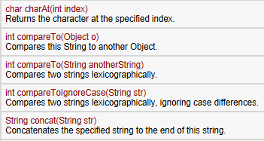

Slide 22
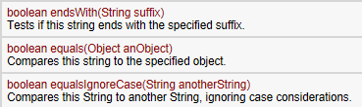

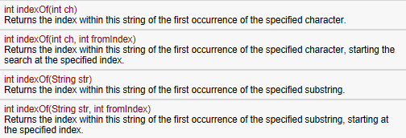

Slide 23
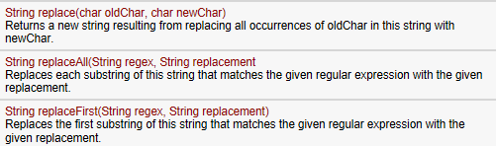


Slide 24
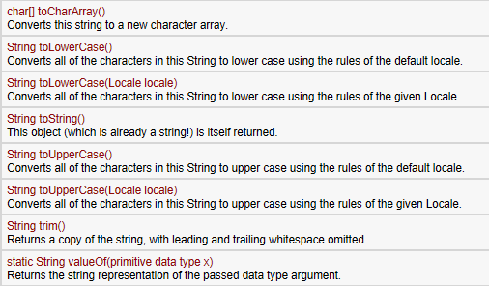

Slide 25
String str = “All String function Example in java”;
System.out.println(“Lower case String ==> ” + str.toLowerCase());
System.out.println(“Upper case String ==> ” + str.toUpperCase());
System.out.println(“Length of the given string ==>” + str.length());
String tempstr = “ String trimming example “; System.out.println(“String after trimming ==> ” + tempstr.trim());
System.out.println(“Character at the index 6 is ==> ” + str.charAt(6));
System.out.println(“String between index 3 to 9 is ==> ” + str.substring(3, 9));
System.out.println(“String after replacement ==> ” + str.replace(‘a’, ‘Y’));
System.out.println(“String after replacement ==> ” + str.replace(“java”, “loan”));

